Slide 1

Name-Shilpa Sahu
Roll No- 20115091
Under supervision of
Dr.Dilip Singh Sisodia
City & Cuisine Based Restaurant Recommendation system using yelp dataset

Slide 2
Content
1.INTRODUCTION
2.OBJECTIVE
3.LITERATURE REVIEW
4.PROPOSED METHODOLOGY
5.EXPERIMENTAL RESULTS
6.CONCLUSION & FUTURE WORK
7.REFERENCES

Slide 3
INTRODUCTION
1

Slide 4
In the world of recommending things, like where to eat, social media is a great place with lots of reviews and user preferences.
As social media gets bigger, there's a need for a system that understands what users really like. This paper suggests a way to do that by using machine learning and looking at reviews and comments from users. The goal is to make personalized recommendations that are better for each user.
The plan is to use a model to check restaurant reviews and give suggestions based on the city and type of food. This way, users can get faster and more relevant recommendations without seeing stuff they don't care about

Slide 5
OBJECTIVE
2

Slide 6
The primary objective of this project is to develop a framework that can effectively extract relevant information from social media data and provide personalized recommendations based on user preferences. This framework will:
To predict the rating of restaurants listed in the Yelp dataset[7] based on analyzing the sentiment of review text given by the user to a particular restaurant. Classification techniques are used.
Enhance user experience by providing graphical User Interface which particularly takes two inputs from user or customers to predict ten best restaurants available in a particular city for a particular cuisine provided by customer.
Identify the services provided by the restaurant, such as price range and business card acceptance.
Reduce information overload by filtering out irrelevant recommendations.

Slide 7
LITERATURE REVIEW
3

Slide 8
S.No. | Research paper title | Method Used | Remarks
1. | [1] Sentiment Analysis of Restaurant Reviews | SVM, Naïve Bayesian Classifier algorithm | SVM is the most useful to exploit the hidden relations between parameters, which the latter method is unable to detect. This is because SVM works geometrically, whereas Naïve Bayesian works on a probabilistic approach to the problem.
2. | [2] “Emotion and sentiment analysis from Twitter text,” | Naïve Bayes classifier | The analysis of different emotions and sentiments showed some interesting human characteristics. All six emotions analyzed can be characterized by multiple dimensions. For example, ‘surprise’ is an emotion which can express both positive and negative sentiments. Someone can be surprised by how stupid or disgusting some people are, which is the negative kind of surprise.
3. | [3]ASentiment analysis-based hotel recommendation using TF-IDF Approach | TF-IDF) and Cosine Similarity | TF-IDF helps to find the weight value of terms or documents frequency and the cosine similarity helps to extract similar kinds of values from the sentiment dataset.
4. | [4] Restaurant Recommendation System for User Preference and Services Based on Rating and Amenities, | NLP algorithm | NLP algorithm improves the performance when compared to existing algorithms
5. | [6]A Machine Learning Approach to Building a Tourism Recommendation System using Sentiment Analysis, | Bernoulli Naïve Bayes, Multinomial Naïve Bayes, Random Forest Classifier, Recurrent Neural Networks and Convolutional Neural Networks | LSTM RNNs generally have a superior performance than traditional RNNs for learning relationships.

Slide 9
PROPOSED METHODOLOGY
4

Slide 10
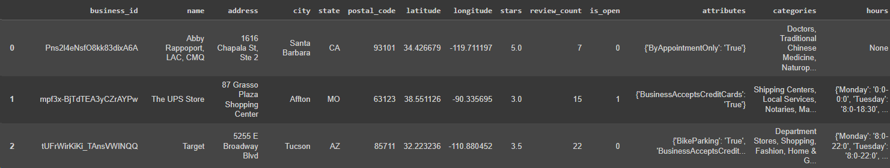
DATASET DESCRIPTION
In this project, we have focused on the following two datasets:
Figure 1 illustrate business objects list name, location, opening hours, category, average star rating, the number of reviews about the business and a series of attributes like noise level ,price range,parking facility or reservations policy.
Figure 1.Attributes of ‘Business’ dataset
Figure 1 .Steps of preprocessing datasets

Slide 11
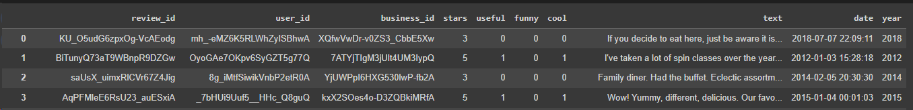
DATASET DESCRIPTION
Figure 2.Review objects list a star rating, the review text, the review date, and the number of votes that the review has received.
Figure 2.Attributes of ‘Review’ dataset
Figure 1 .Steps of preprocessing datasets

Slide 12
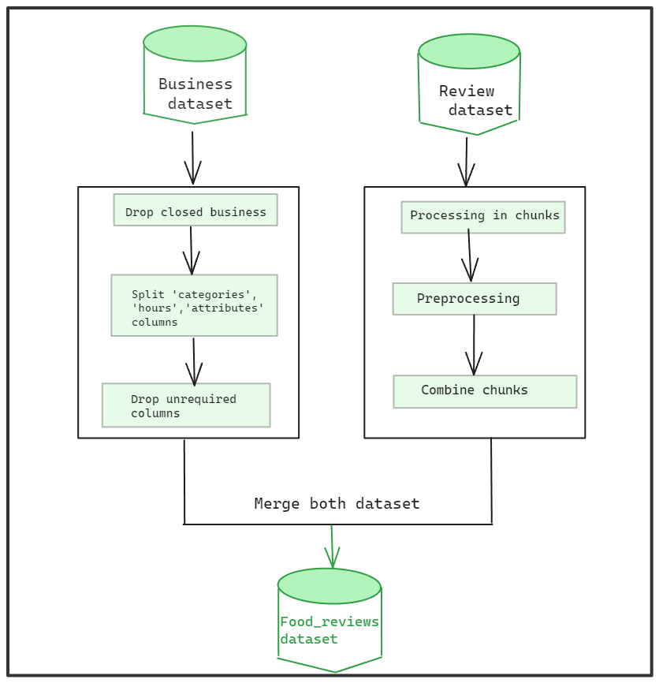
DATA PREPROCESSING
Figure 3 .Steps of preprocessing datasets

Slide 13
DATA PREPROCESSING:
Step-by-Step explanation
Business Dataset Preprocessing:
Drop Closed Businesses
Organize Data for Further Analysis:
Split 'categories' column into separate columns using commas as separators.
Split 'hours' column into separate columns for each day of the week and its corresponding hours.
Split 'attributes' column into separate columns for specific attributes.

Slide 14
DATA PREPROCESSING
Step-by-Step explanation
2) Review Dataset Processing:
Efficient Chunk Processing:Use a chunking approach to handle the large review dataset (approximately 69,90,280 rows) for better memory management.
Date-Related Processing:Perform date-related processing on each chunk, extracting and formatting date information from reviews.
Combining Processed Chunks:Combine processed chunks of the review dataset into a final DataFrame.
3) Merging Business and Review Datasets:
Merge preprocessed business and review datasets to create a comprehensive dataset combining business information with customer feedback.

Slide 15
PROPOSED METHODOLOGY
OVERVIEW
The suggested method incorporates the outcomes of the Sentiment Analysis process. Figure 4 illustrates the primary components and interactions of the proposed system. The Yelp Restaurants Reviews [7] dataset serves as input for the sentiment analyzer, generating a sentiment score as output. This score is then forwarded to the recommender system to generate a top-n items recommendation list.

Slide 16
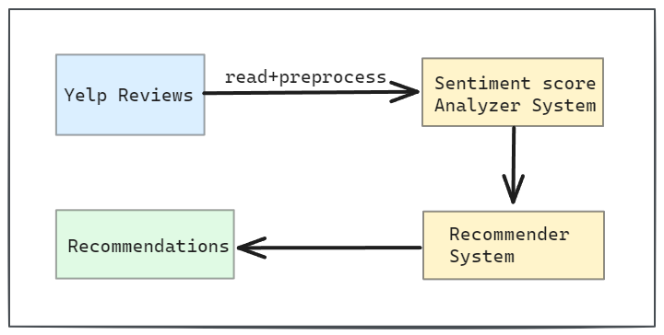
PROPOSED METHODOLOGY
Fig 4.Overall System Architecture

Slide 17
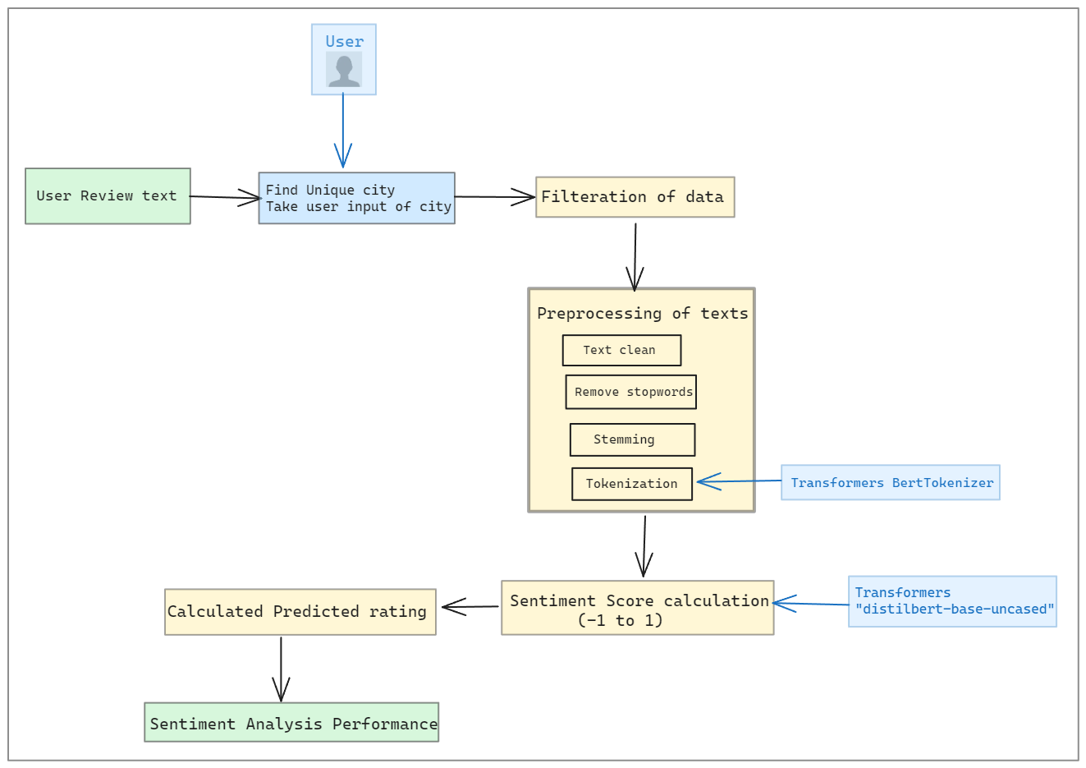
PROPOSED METHODOLOGY
Sentiment Analysis on Restaurants Reviews
This image[5] illustrates the sequential steps in the sentiment analysis process:
Figure 5.Proposed steps for sentiment analysis of review texts

Slide 18
Sentiment Analysis on Restaurants Reviews
Step-by-Step explanation
Data Collection:
Processed dataset(business+review) from Yelp Restaurants Reviews includes business ID, review date, star ratings, user IDs, and review text.
Filtration:
User-driven filtration based on city preferences for region-specific analysis.
Text Preprocessing:
a. Text Cleaning: Remove formatting quirks, punctuation, and whitespaces.
b. Removal of Stopwords: Eliminate common words with low information value.
c. Stemming: Use Porter stemming algorithm for word normalization.
d. Lowercasing: Convert all characters to lowercase for consistency.
e. Tokenization: Use Bert Tokenizer for breaking down text into tokens.

Slide 19
Sentiment Analysis on Restaurants Reviews
Step-by-Step explanation
Sentiment Score Calculation:
Utilize "DistilBert" [11] model for sentiment analysis.
Scores provide quantitative representation of emotional tone.
Scores range from 0 to 1, indicating positive to negative sentiment.
Predicting Rating Based on Sentiment Score:
Transform sentiment score (S) to the range [0, 5].
Predicted Rating = (S + 1) / 2 * 5.
Performance of Sentiment Analysis:
Evaluate model performance using metrics:
MAE (Mean Absolute Error): Measures precision by calculating average absolute differences between predicted and actual ratings.
MSE (Mean Squared Error): Penalizes larger errors, offering insights into overall model performance.

Slide 20
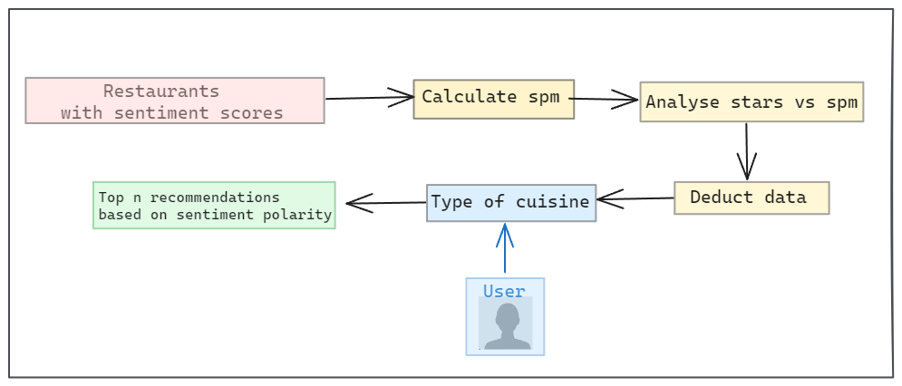
Restaurant Recommendation System
This Figure 6 illustrates the process of recommending restaurants:
Figure 6.Recommender system overview

Slide 21
Restaurant Recommendation System
Step-by-Step explanation
Sentiment Score Integration:
Each restaurant associated with a sentiment score from customer reviews.
Mean Sentiment Polarity Calculation (spm):
Calculate mean sentiment polarity by grouping entries based on unique business ID.
Stars vs. Sentiment Polarity Analysis:
Explore relationship between star ratings and mean sentiment polarity.
Analysis:Star Distribution Above 3.5: Restaurants with ratings above 3.5 mostly have sentiment polarity between 0 and 0.5.
Refined Dataset Criteria:Focus on positive sentiments and high ratings.
Isolate rows with star rating > 3.5 and sentiment polarity > 0.

Slide 22
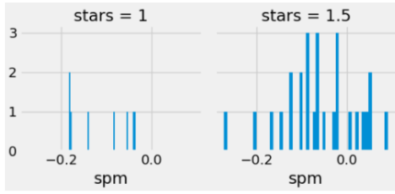
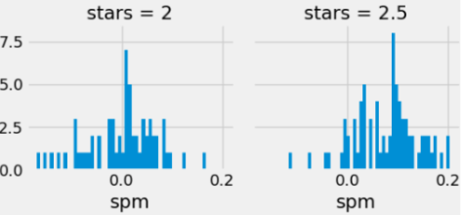
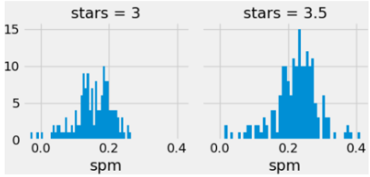
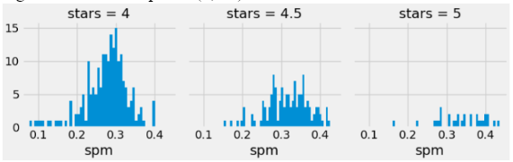
Restaurant Recommendation System
Step-by-Step explanation
Stars vs. Sentiment Polarity Analysis:
Figures explores relationship between star ratings and mean sentiment polarity:

Slide 23
Restaurant Recommendation System
Step-by-Step explanation
User-Cuisine-Centric Recommendations:
Two-tiered approach: considers both city and cuisine preferences.
Recommendations prioritize top establishments based on sentiment polarity.
Enhances the likelihood of a positive and enjoyable dining experience for users.

Slide 24
EXPERIMENTAL RESULTS
4

Slide 25
EXPERIMENTAL RESULTS
RANDOM FOREST Algorithm:
Work2vec tokenization.
Random Forest classification, 66% accuracy.
LSTM Model:
Keras tokenizer
Embedding layer, SpatialDropout1D, and LSTM, 70% accuracy.
DistilBERT:
Remarkable 83% accuracy.
Outperforms TF-IDF, LSTM, and word2vec.
Demonstrates DistilBERT's superior effectiveness in sentiment analysis.

Slide 26
EXPERIMENTAL RESULTS
Model | Tokenizer | Accuracy | MSE | MAE
distilbert-base-uncased | ‘DistilBert’ Tokenizer | 0.83 | 0.34 | 0.45
LSTM | ‘keras’ Tokenizer | 0.70 | 0.41 | 0.51
Random forest | ‘Word2vec’ Tokenizer | 0.66 | 0.69 | 0.45

Slide 27
CONCLUSION & FUTURE WORK
5

Slide 28
Conclusion
In conclusion, the integration of DistilBERT for sentiment analysis in our restaurant recommendation system has significantly elevated the accuracy and personalization of user experiences. By combining user input on city and cuisine preferences with DistilBERT's nuanced sentiment understanding, our system provides tailored recommendations based not only on high ratings but also positive sentiments expressed in reviews. DistilBERT's efficiency and accuracy align with our commitment to user satisfaction, offering a refined and enjoyable dining journey.

Slide 29
Future Work
Explore larger, diverse datasets for enhanced model adaptability.
Increase accuracy through further optimization such as city-based filtering, considering additional criteria for precise sentiment analysis and will improve recommendation accuracy
Investigate domain-specific pre-training, tailoring sentiment analysis to industries.
Continuous refinement for adaptation to evolving language patterns and user behaviors is crucial for sustained efficacy and relevance in dynamic real-world scenarios.

Slide 30
REFERENCES
[1] R. Rajasekaran, U. Kanumuri, M. Siddhardha Kumar, S. Ramasubbareddy, and S. Ashok, “Sentiment Analysis of Restaurant Reviews,” in Smart Intelligent Computing and Applications, Singapore: Springer Singapore, 2018, pp. 383–390 [Online]. Available: http://dx.doi.org/10.1007/978-981-13-1927-3_41. [Accessed: Nov. 30, 2023]
[2]K. Sailunaz and R. Alhajj, “Emotion and sentiment analysis from Twitter text,” Journal of Computational Science, vol. 36, p. 101003, Sep. 2019, doi: 10.1016/j.jocs.2019.05.009.
[3]R. K. Mishra, S. Urolagin, and A. A. Jothi J, “A Sentiment analysis-based hotel recommendation using TF-IDF Approach,” in 2019 International Conference on Computational Intelligence and Knowledge Economy (ICCIKE), Dec. 2019 [Online]. Available: http://dx.doi.org/10.1109/iccike47802.2019.9004385. [Accessed: Nov. 30, 2023]
[4]X. Wang, I. Ounis, and C. Macdonald, “Comparison of Sentiment Analysis and User Ratings in Venue Recommendation,” in Lecture Notes in Computer Science, Cham: Springer International Publishing, 2019, pp. 215–228 [Online]. Available: http://dx.doi.org/10.1007/978-3-030-15712-8_14. [Accessed: Nov. 30, 2023]
[5]R. M. Gomathi, P. Ajitha, G. H. S. Krishna, and I. H. Pranay, “Restaurant Recommendation System for User Preference and Services Based on Rating and Amenities,” in 2019 International Conference on Computational Intelligence in Data Science (ICCIDS), Feb. 2019 [Online]. Available: http://dx.doi.org/10.1109/iccids.2019.8862048. [Accessed: Nov. 30, 2023]
[6]A. Kulkarni, R. M., P. Barve, and A. Phade, “A Machine Learning Approach to Building a Tourism Recommendation System using Sentiment Analysis,” International Journal of Computer Applications, vol. 178, no. 19, pp. 48–51, Jun. 2019, doi: 10.5120/ijca2019919031.

Slide 31
REFERENCES
[7] [Inc. Yelp, “Yelp Dataset,” Kaggle. [Online]. Available: https://www.kaggle.com/datasets/yelp-dataset/yelp-dataset. [Accessed: Nov. 30, 2023]
[8]I. Maks and P. Vossen, “A lexicon model for deep sentiment analysis and opinion mining applications,” Decision Support Systems, vol. 53, no. 4, pp. 680–688, Nov. 2012, doi: 10.1016/j.dss.2012.05.025.
[9]W. Medhat, A. Hassan, and H. Korashy, “Sentiment analysis algorithms and applications: A survey,” Ain Shams Engineering Journal, vol. 5, no. 4, pp. 1093–1113, Dec. 2014, doi: 10.1016/j.asej.2014.04.011.
[10]G. Preethi, P. V. Krishna, M. S. Obaidat, V. Saritha, and S. Yenduri, “Application of Deep Learning to Sentiment Analysis for recommender system on cloud,” in 2017 International Conference on Computer, Information and Telecommunication Systems (CITS), Jul. 2017 [
[11]V. Sanh, “🏎 Smaller, faster, cheaper, lighter: Introducing DistilBERT, a distilled version of BERT,” HuggingFace, Aug. 31, 2020 [Online]. Available: https://medium.com/huggingface/distilbert-8cf3380435b5. [Accessed: Nov. 30, 2023]

Slide 32
THANKS!

